Slide 1
A project report on
Mail verification using SMTP protocol
Course code: CSE 420
Course Title: Mobile and Wireless Communication (Sessional)
Level-4 Semester-I
Team Members:
Md : Sazzad Hossain(1902024)
Mehedi Hasan (1902044)
Md.Moshiur Rahman (1702060)
Md:Jamil Hossain(1902058)
Ahsanul Zahid (1902007)
Department Of Computer Science and Engineering.
Hajee Mohammad Danesh Science and Technology University,5200
Dinajpur.

Slide 2
What Is Email OTP Verification:
Email OTP verification is a method of authenticating a user's email address by sending a one-time password (OTP) to their registered email address

Slide 3
How It Works:
1.When a user tries to authenticate on any device, a server sends an email with an OTP to the registered email address.
2.The OTP can be used for single authentication within a short time frame.
3.OTP verification can be used to verify a user's email address and prevent the registration of fake or invalid accounts.

Slide 4
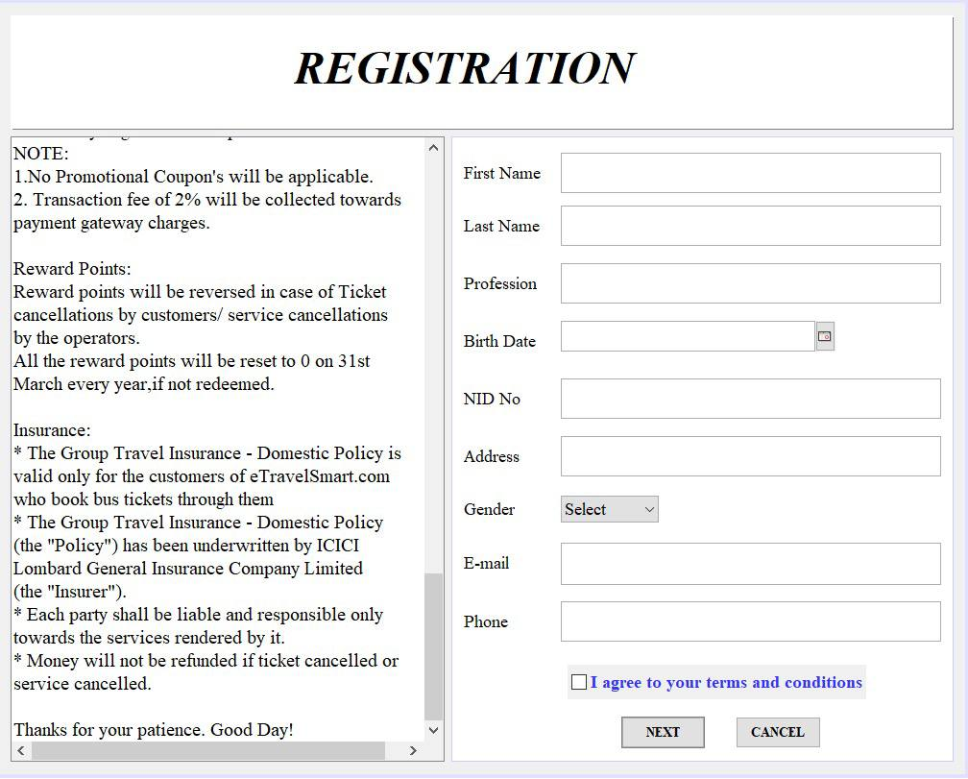
Registration And OTP Genarator:

Slide 5
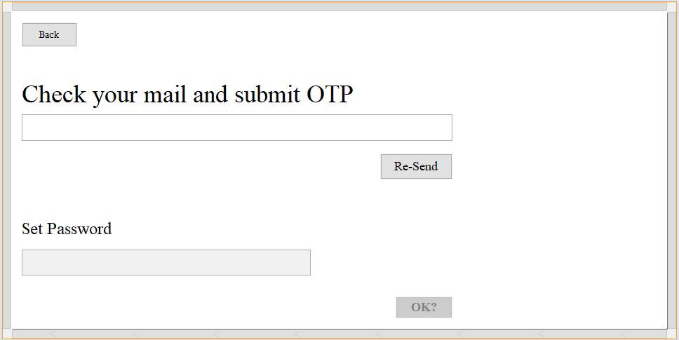
OTP Check:

Slide 6
Advantage:
Security: OTPs are secure because they are unpredictable, complex, and not stored on a computer. They are also safe from replay attacks.
Prevention: OTPs can prevent unauthorized access, account takeovers, and protect sensitive user data. They can also prevent fake or spam accounts.
Convenience: OTPs can reduce friction for users by preventing them from having to remember their password. OTPs can also support multiple delivery methods, such as email, SMS, and authenticator apps.
Compatibility: OTPs are compatible with existing authentication methods.
Flexibility: OTPs can be flexible for different types of use cases.

Slide 7
Disadvantage:
Security risks: Emails can be intercepted or redirected, and email accounts can be compromised through phishing or malware attacks. OTPs can also be vulnerable to intelligent phishing, pharming, and social engineering attacks, which can lead to the theft of sensitive information.
Delayed or spammed emails: Some emailed OTPs may be delayed or end up in a Spam folder.
Loss of access: If a user loses a physical token, they've lost access to their OTP.
Unencrypted mediums: The use of unencrypted mediums for delivering OTP messages can increase the risk of ATM fraud.
Low security: Identity providers can track, trace, run analytics, and sell your data to someone else.
Compromise easily: OTP authentication can be compromised fairly easily.

Slide 8
Conclusion:
OTP verification is one of the ways to ensure the identity of a person during transactions, registration, etc. OTP verification provides additional security along with the static password method. It also helps to reduce cyber crimes as the expiry time of OTP is just a few minutes.

Slide 9


